Slide 1
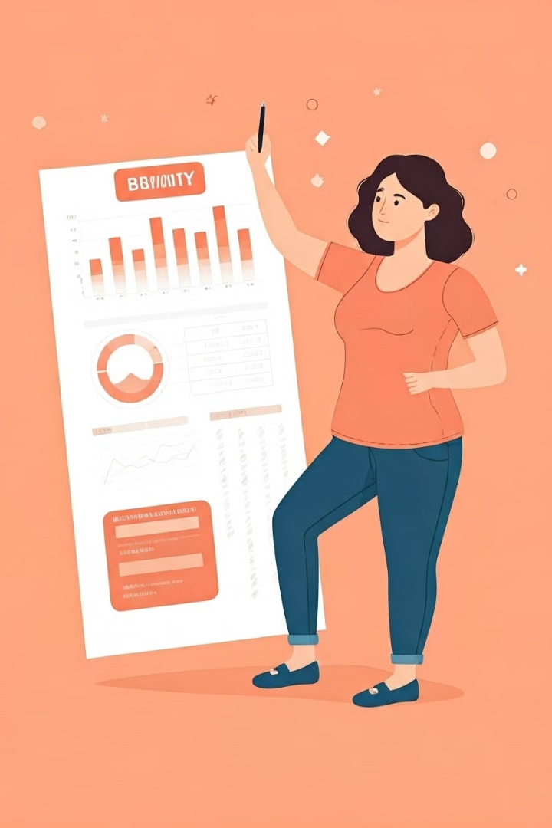
Obesity Risk Prediction Project
This project aims to develop a machine learning model to predict obesity risk in individuals based on various attributes. Obesity is a critical factor related to cardiovascular diseases, making early prediction essential for preventive healthcare.

Slide 2
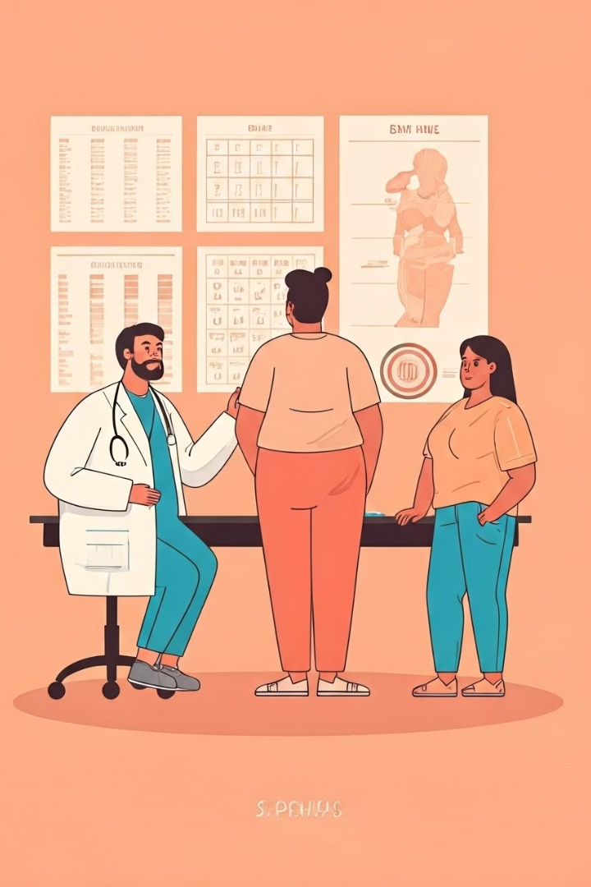



Problem Definition & Objectives
Project Goal
Health Significance
Develop a machine learning model to predict obesity risk in individuals based on various attributes.
Obesity is a critical factor related to cardiovascular diseases, making early prediction essential for preventive healthcare.
Business Impact
By accurately predicting obesity risk, the model can assist healthcare providers, policymakers, and individuals in making informed decisions about lifestyle changes and early interventions. This can lead to reduced healthcare costs and improved public health outcomes.

Slide 3
Dataset Attributes
Personal Attributes
Eating Habits
Physical Condition
Gender: Biological sex of the individual
Frequent consumption of high caloric food (FAVC): Whether the person regularly consumes high-calorie foods
Calorie consumption monitoring (SCC): Whether the person actively monitors their calorie intake
Height: Height of the person (in meters)
Age: Age of the individual
Frequency of consumption of vegetables (FCVC): How often the individual eats vegetables
Physical activity frequency (FAF): Regularity of physical activity
Weight: Current body weight (in kg)
Family history with overweight: Whether there is a genetic predisposition to overweight
Time using technology devices (TUE): Duration spent using electronic devices daily
Number of main meals (NCP): Daily number of main meals consumed
Smoking habit (SMOKE): Whether the person smokes or not
Consumption of food between meals (CAEC): Snacking habits between meals
Transportation used (MTRANS): Mode of transportation used (e.g., walking, cycling, public transport, car)
Consumption of water daily (CH2O): Amount of water intake per day
Consumption of alcohol (CALC): Frequency of alcohol consumption

Slide 4
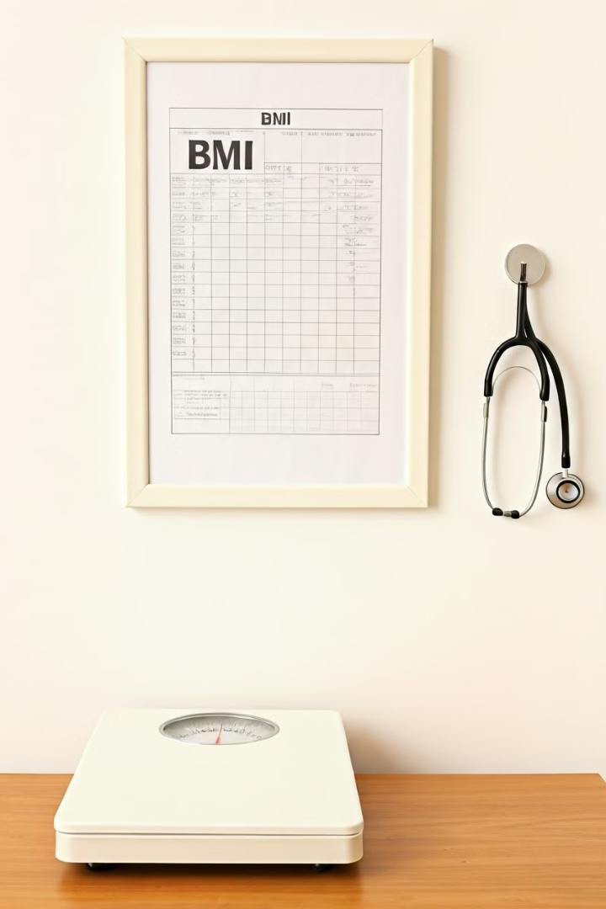
BMI Categories
Category
BMI Range
Insufficient Weight
Less than 18.5
Normal
18.5 to 24.9
Overweight
25.0 to 29.9
Obesity I
30.0 to 34.9
Obesity II
35.0 to 39.9
Obesity III
Higher than 40

Slide 5
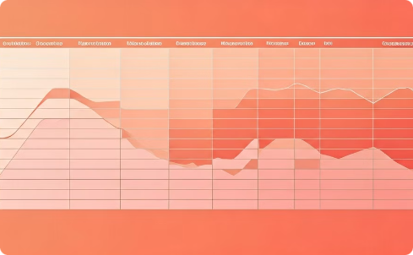
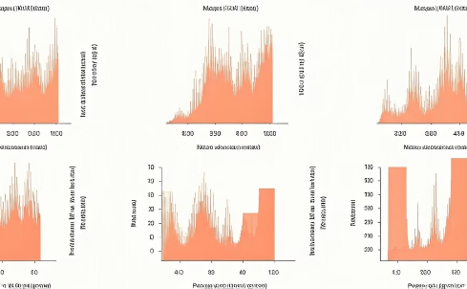
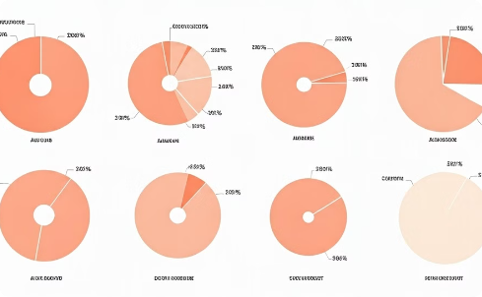
Exploratory Data Analysis
Correlation Analysis
Distribution Analysis
Categorical Variables
The correlation matrix revealed several significant relationships between variables. Height and Weight showed a moderate positive correlation (0.42), while Age and Weight also demonstrated a positive relationship (0.28). Interestingly, Age and Time using technology devices (TUE) showed a negative correlation (-0.30).
Histograms of numerical features revealed varying distributions. Age showed a right-skewed distribution with most participants being young adults. Weight distribution was bimodal, reflecting the different obesity categories in the dataset.
Pie charts revealed imbalances in several categorical variables. Most notably, the MTRANS (transportation mode) variable showed extreme imbalance with Public Transportation being the dominant category (80.4%).

Slide 6



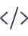
Data Insights & Preprocessing
Numerical Features Analysis
Transformed Age to integers, Height to centimeters, and rounded other numerical features for better interpretability
Outliers Analysis
Identified outliers in Age and NCP using IQR method, indicating potential data entry issues
Categorical Feature Imbalance
Detected severe imbalances in MTRANS (521.47 ratio), SMOKE (83.73), and CAEC (62.83)
Encoding Implementation
Applied Label Encoding for binary features, Ordinal Encoding for ordered categories, and One-Hot Encoding for MTRANS

Slide 7

Model Selection & Training
Tree-based Models Advantages
Models Evaluated
Random Forest with StandardScaler pipeline
Not affected by feature magnitudes as they split data based on conditions
Decision Tree with StandardScaler pipeline
Do not rely on the scale of numerical features
XGBoost with StandardScaler pipeline and mlogloss evaluation metric
Work well with interpretability requirements
Effective for small datasets and high-dimensional data
Evaluation Approach
80-20 train-test split with random state 42
5-fold cross-validation with KFold
Accuracy as primary metric
Boxplot visualization of cross-validation results

Slide 8
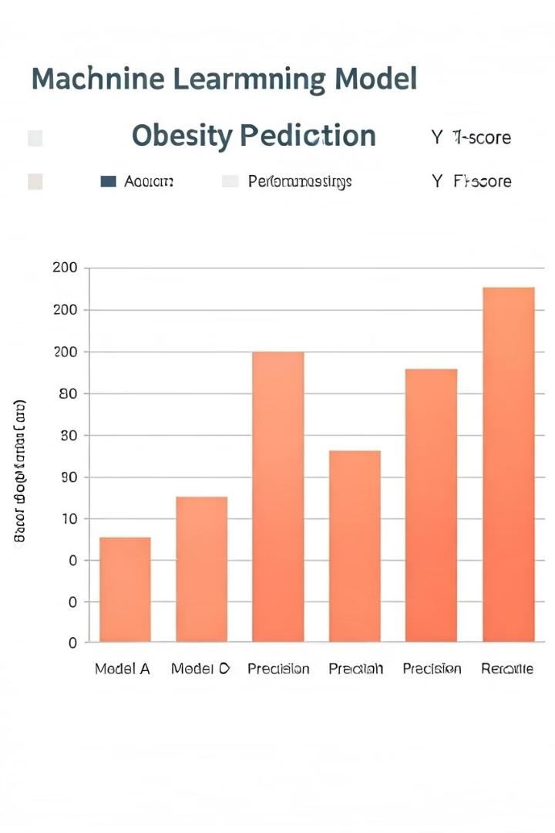
Model Performance Comparison
89.28%
Random Forest
Solid performance with good generalization
83.96%
Decision Tree
Lowest accuracy among tested models
90.03%
XGBoost
Best performing model before tuning
90.94%
Tuned XGBoost
Highest accuracy after hyperparameter optimization
Based on the accuracy comparison, XGBoost demonstrated the best performance even before tuning. After hyperparameter optimization through RandomizedSearchCV, the tuned XGBoost model achieved the highest accuracy of 90.94%, making it the clear choice for our obesity prediction task.

Slide 9
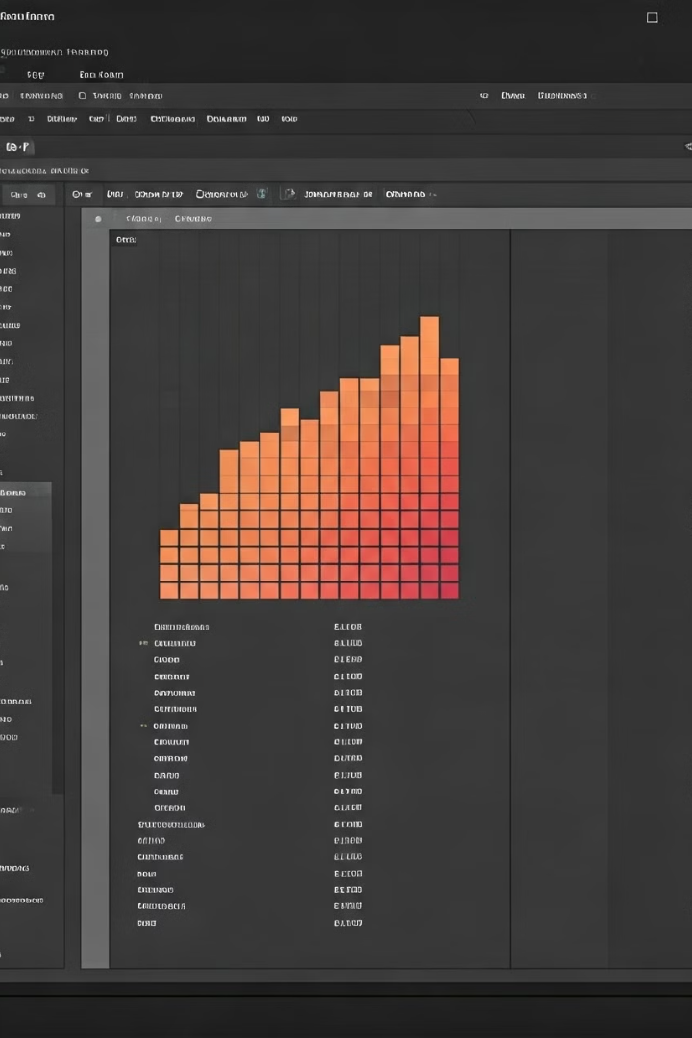
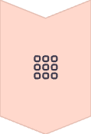

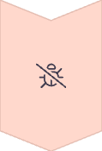

XGBoost Hyperparameter Tuning
Parameter Grid Definition
Created a comprehensive grid with parameters including n_estimators, max_depth, learning_rate, gamma, reg_lambda, and reg_alpha
Randomized Search
Implemented RandomizedSearchCV with 10 iterations and 5-fold cross-validation
Best Parameters
Identified optimal configuration: n_estimators=300, max_depth=3, learning_rate=0.2, gamma=0, reg_lambda=1, reg_alpha=1
Validation
Evaluated final model on test set, achieving 90.94% accuracy

Slide 10
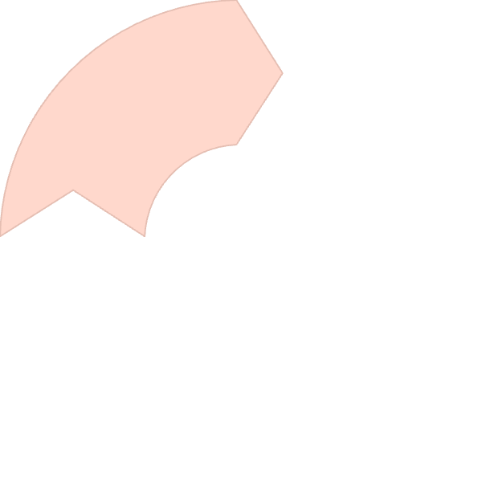
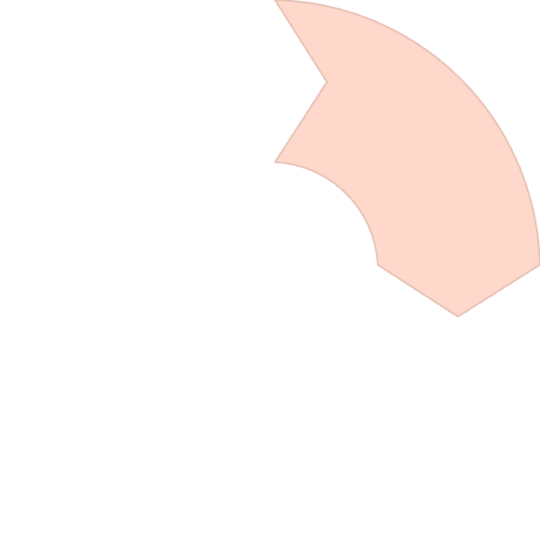






Final Model Evaluation
Class-wise Performance
Overall Accuracy
Obesity Type I and II showed highest precision (98-100%), while Obesity Type II and III had lower precision (80-82%)
The tuned XGBoost model achieved 90.94% accuracy on the test set
Learning Curve
Confusion Matrix
Model showed consistent improvement during training with minimal gap between train and test performance
Revealed strong classification performance across all seven obesity categories
The classification report showed excellent performance across all obesity categories, with precision, recall, and F1-scores consistently above 0.80. The model performed exceptionally well for Obesity Type I (0.98 precision) and Obesity Type II (1.00 precision), while showing slightly lower but still strong performance for Obesity Type II and III (0.80-0.82 precision).

Slide 11
Prepared by:
Abdullah Mahmoud
Ali Salama
Sara Nabil
Sara Gamil

Slide 12
Thank You

